Slide 1
Heart Disease Prediction using ML
Kenneth Foo, AI Applications, D4AE Project

Slide 2


© Kenneth Foo. All rights reserved
AI Applications Student | D4AE Graded Assignment
Honor Pledge for Graded Assignments
“I affirm that I have not given or received any unauthorized help on this assignment, and that this work is my own.”
Signature:

Slide 3
Table of Contents
Problem Statement.
Data acquisition and Data exploration.
Modelling.
Evaluation and Deployment.

Slide 4
Problem Statement
Who:
Medical Doctors or Scientists who want to do human-over-the loop approach to predict heart disease.
What:
This is a binary classification problem.
Involves going through dataset:
Exploratory Data Analysis.
Creating models.
Comparing models.
Fine-tuning models
Feature Importance.
Cross-Validation

Slide 5
Problem Statement
Where:
Medical Facilities like hospitals or research laboratories or Biotechnology companies.
Why:
Using methods such as machine learning accompanied with a human-over-the-loop approach can deliberately reduce the work for medical doctors.
Machine Learning methods can be used as the secondary tool to assist medical doctors on hypothesis.

Slide 6
Data Acquisition and Exploration
Checking if label are balanced or not
Dataset label
0s & 1s
Can be considered balanced with a margin of 27
1
0
165
138
27

Slide 7
Data Acquisition and Exploration
Heart Disease Frequency according to Gender
Compare how sex(male/female) affects the likelihood of heart disease
=
Female heuristic
Sex
0
1
Target
24 | 114
72 | 93
=
Male heuristic
96 females
(0) 24
(1) 72
70% chance of getting heart disease
0
207 males
(0) 114
(1) 93
50% chance of getting heart disease
1

Slide 8
Data Acquisition and Exploration
Heart Disease Frequency according to chest pain
Compare chest pain affects the likelihood of heart disease
Target
0
1
=
No heart disease
Cp
104 | 39
9 | 41
18 | 69
7 | 16
=
Heart disease
0
You can see that the target 0 a type 0(typical angina) chest pain scores the highest
1
2
You can see that the target 1 a type 2(Non-anginal pain) chest pain scores the highest
3

Slide 9
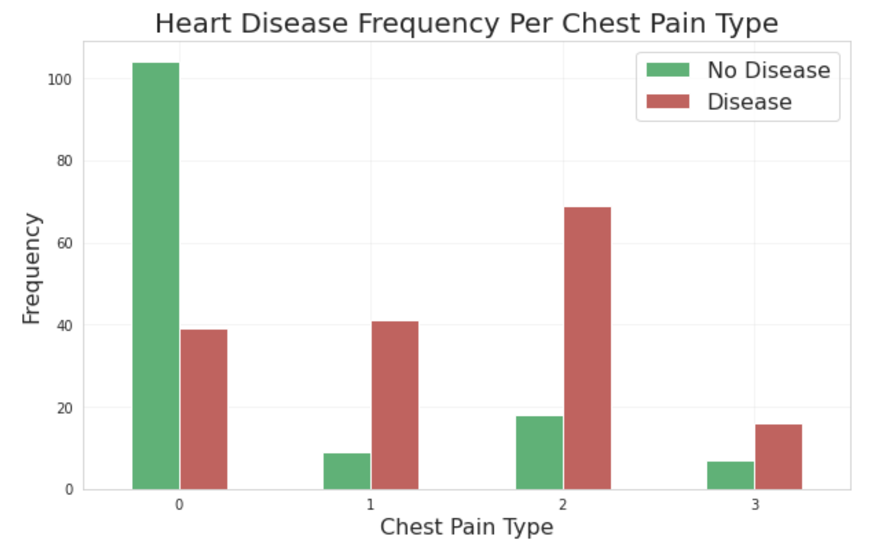
Data Acquisition and Exploration
Heart Disease Frequency according to chest pain
Compare chest pain affects the likelihood of heart disease

Slide 10
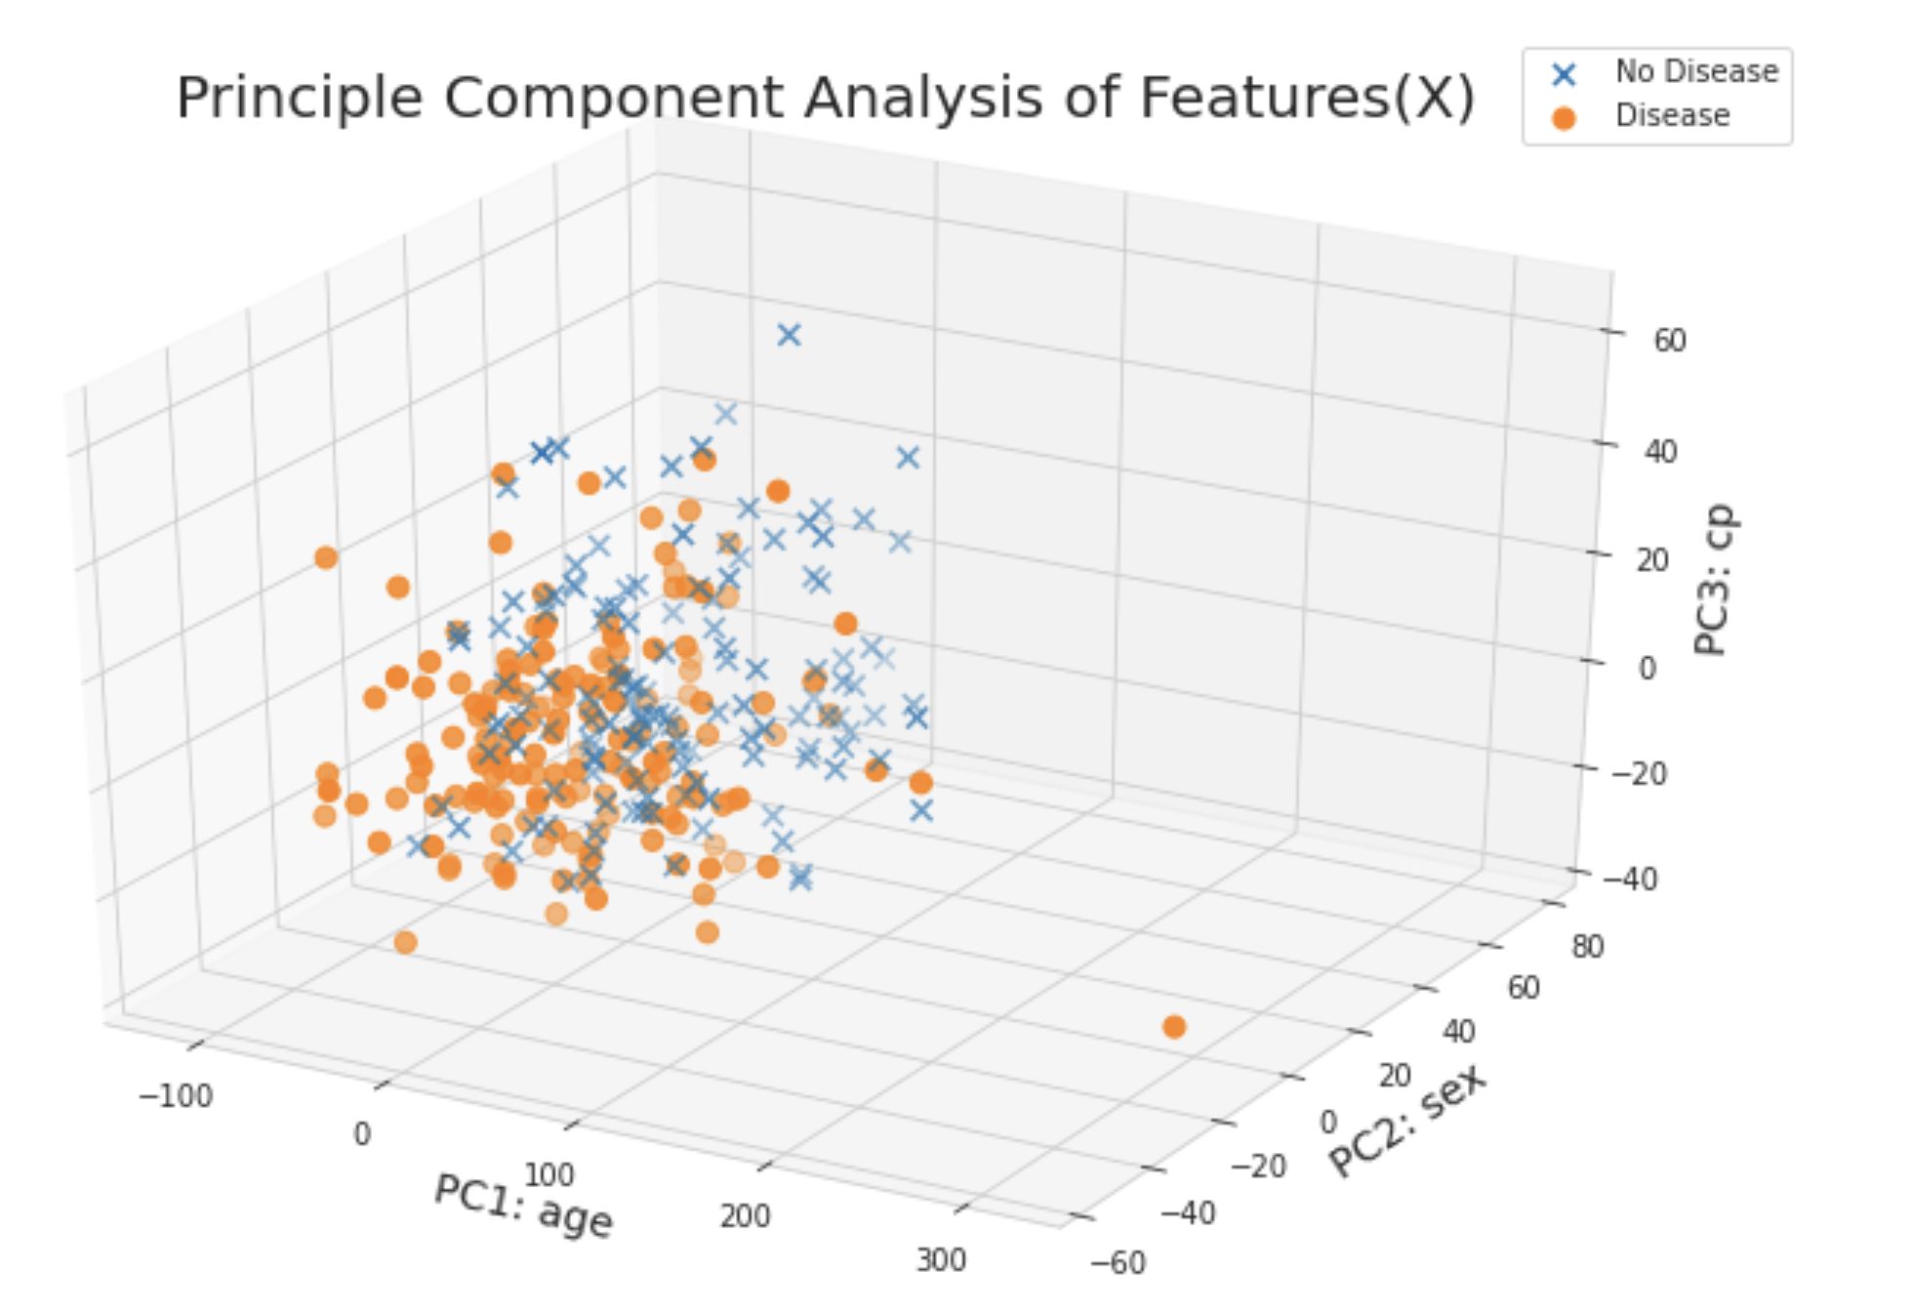
Data Acquisition and Exploration
Principle Component Analysis(Under Experiments)
Reduce dimensionality and do feature selection
These were the 3 PCA components that were selected
Age
Sex
Cp

Slide 11
Data Acquisition and Exploration
Principle Component Analysis
Reduce dimensionality and do feature selection
They have the highest explained variance ratio(evr) out the the 13 features and the number of components selected would depend on the evr threshold of 0.05
Principle Component 1 (age)EVR: 0.747564
Principle Component 2 (sex)EVR: 0.150370
Principle Component 3 (cp)EVR: 0.084597

Slide 12
Modelling
Train Test Split
Size of training and testing data
Total size of data
303
Training
242
61
Testing

Slide 13
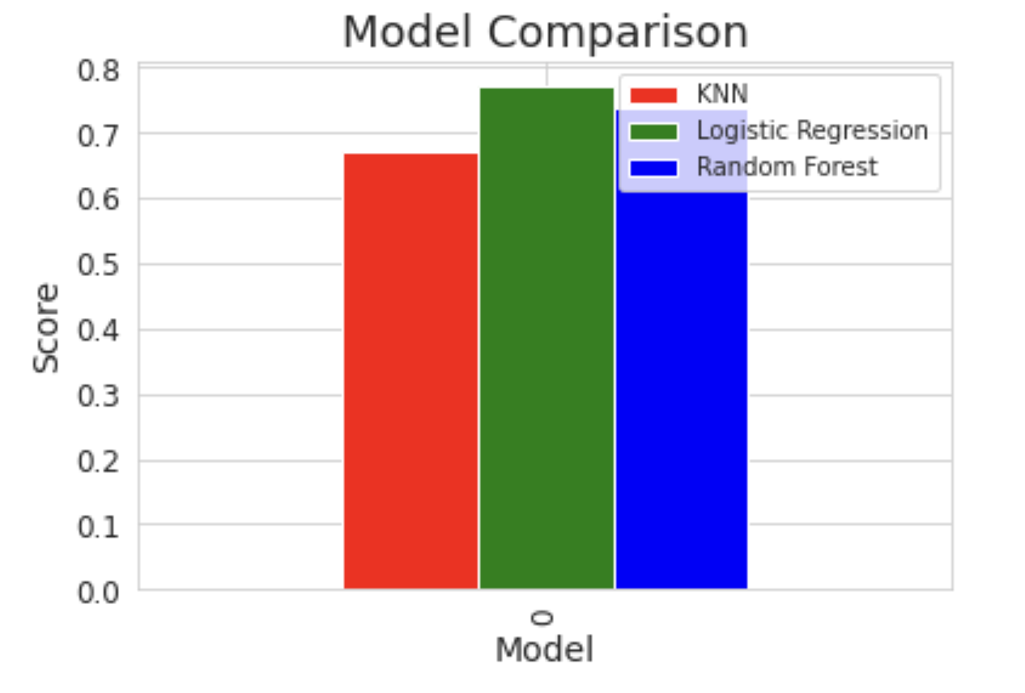
Modelling
Model choices
The type of models I tried for this dataset
Logistic Regression: 0.7704918032786885 acc
K-Nearest Neighbour: 0.6721311475409836 acc
Random Forest: 0.7377049180327869 acc

Slide 14
Modelling
Hyperparameter Tuning
By hand on KNN
K-Nearest Neighbour: 0.6721311475409836 acc
Do so by increasing n neighbours in a range of 1-20

Slide 15
Modelling
Hyperparameter Tuning
Using GridSearch on Logistic Regression
Logistic Regression: 0.7704918032786885 acc
Perform the grid search on the Logistic Regression grid with a regularisation parameter of logspace(-4, 4, 20) and a optimisation algorithm of liblinear
Improved accuracy
Logistic Regression: 0.819672131147541 acc
=

Slide 16
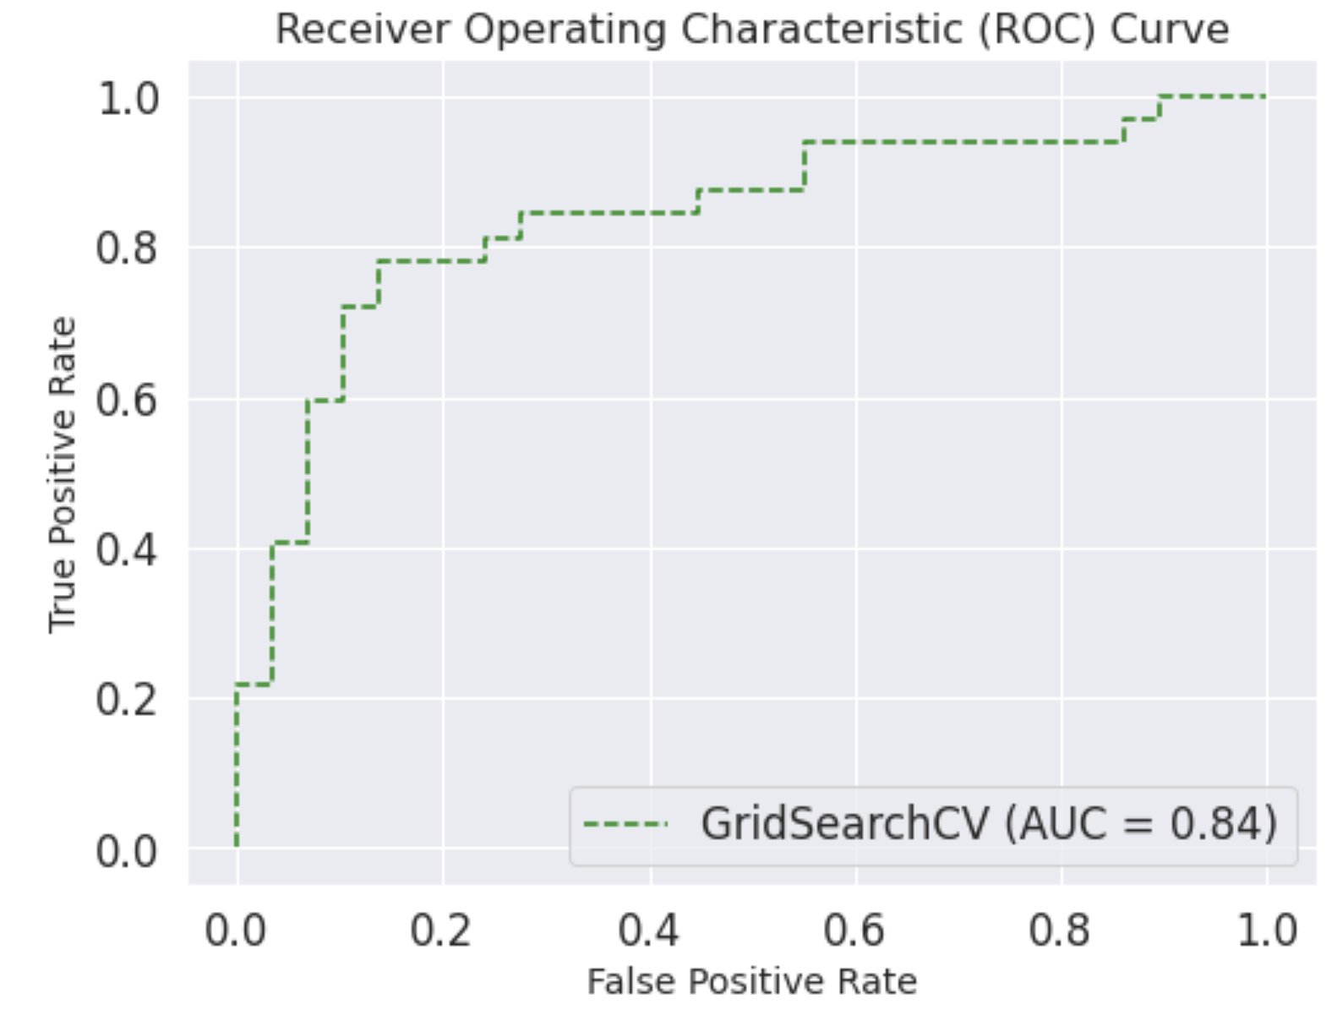
Evaluation and Deployment
ROC curve and AUC score
X_test, y_test
A higher AUC indicates that the model has better predictive performance in terms of distinguishing between the positive and negative classes.

Slide 17
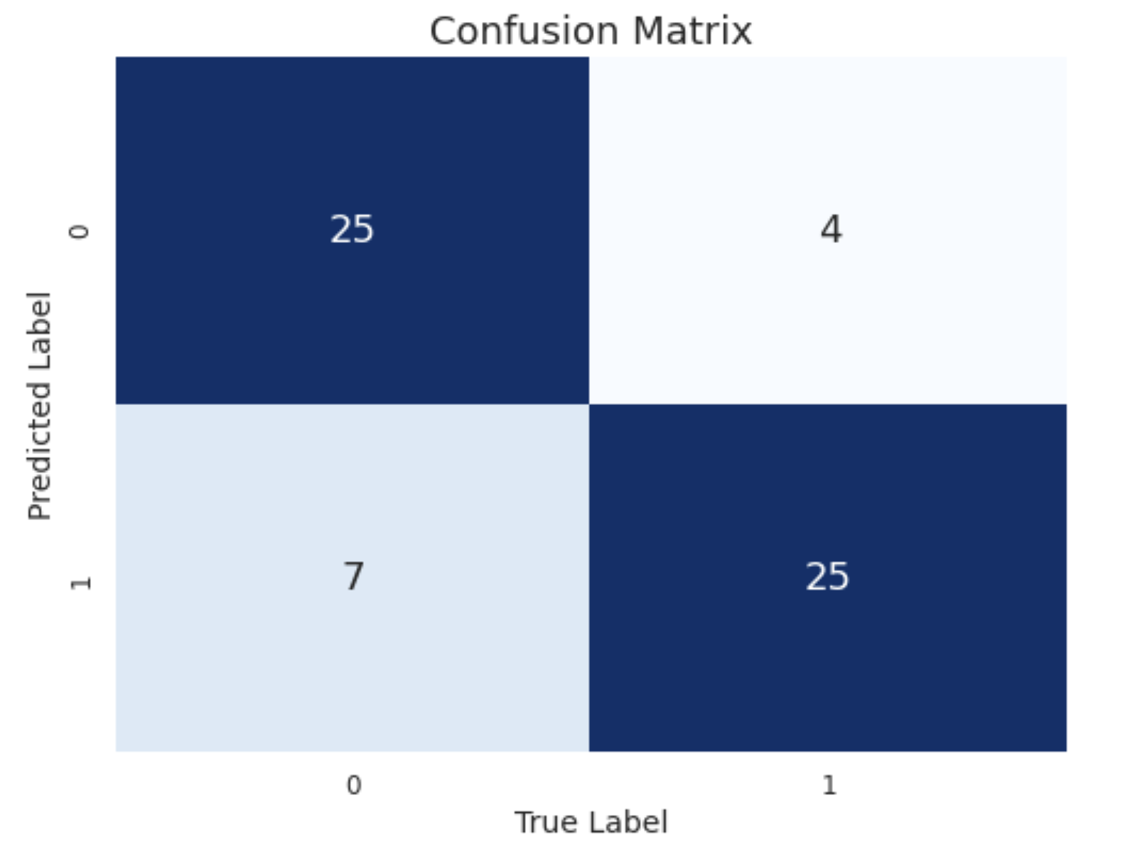
Evaluation and Deployment
Confusion Matrix
y_test, y_pred
You can see that for label 0, there are 7 wrongly classified as label 1
Whereas for label 1, there are 4 wrongly classified as label 0

Slide 18
Evaluation and Deployment
Classification Report
y_test, y_pred
 | Precision | Recall | F1-score | Support
0 | 0.78 | 0.86 | 0.82 | 29
1 | 0.86 | 0.78 | 0.82 | 32
Accuracy |  |  | 0.82 | 61
Macro avg | 0.82 | 0.82 | 0.82 | 61
Weighted avg | 0.82 | 0.82 | 0.82 | 61
The dataset seems to be balanced as the support for both classes are similar
Overall, this classification report suggests that the model has a balanced performance in terms of precision and recall for both classes and an accuracy of 82%.

Slide 19
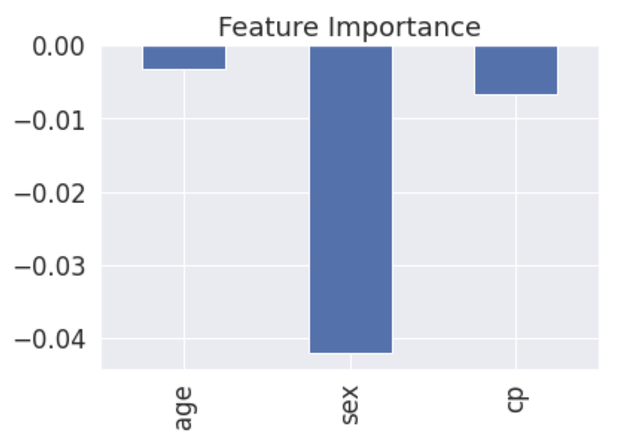
Evaluation and Deployment
Feature Importance
Age, sex, cp
As the value of sex increases, the target value decreased
Target
0
1
24 | 72
114 | 93
Sex
0
1

Slide 20
Thank you

